Slide 1
tuberculosis

Slide 2
Tuberculosis - a chronic infectious disease in which may be affected all human organs and tissues, but most pathological process develops in the lungs.

Slide 3
Etiology:
1.M.tuberculosis - 92-95%
2M.bovis -5%
In AIDS patients
3.M.avium
4.M.intracellulare

Slide 4
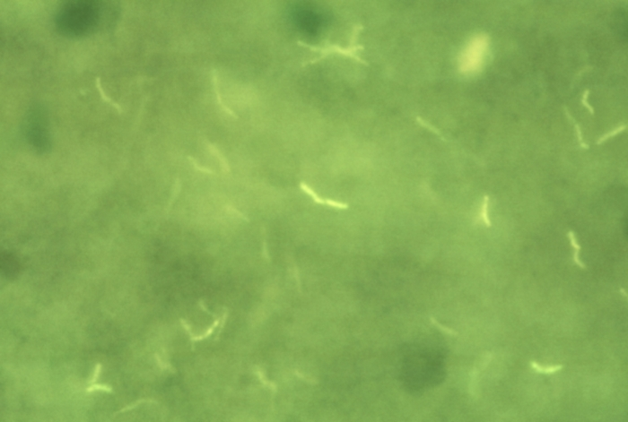
Mycobacterium tuberculosis in sputum specimen; Fluorescent micrograph; rhodamine and auramine coloring; × 500.

Slide 5
Epidemiology.
Mycobacterium tuberculosis is responsible for most cases of tuberculosis; the reservoir of infection is humans with active tuberculosis. The main way of transmission is airborne and airborne dust. Oropharyngeal and intestinal tuberculosis contracted by drinking milk contaminated with M. bovis is rare in countries where milk is routinely pasteurized, but it is still seen in countries that have tuberculous dairy cows and unpasteurized milk. Tuberculosis flourishes wherever there is poverty, crowding, and chronic debilitating illness.

Slide 6
Classification:
Primary tuberculosis
hematogenous tuberculosis
Secondary tuberculosis

Slide 7
Primary tuberculosis
It is characterized by:
the development of the disease in the period of becoming infected;
sensitization and allergy;
predominance of exudative-necrotic changes;
tendency to hematogenous and lymphogenous generalization.
Children get sick more often.

Slide 8
The main form of primary tuberculosis is the primary pulmonary tuberculosis complex. It consists of three components: primary affect in the lung, lymphadenitis and lymphangiitis.
The primary affect is usually localized in the upper part of the lower lung near the pleura.

Slide 9
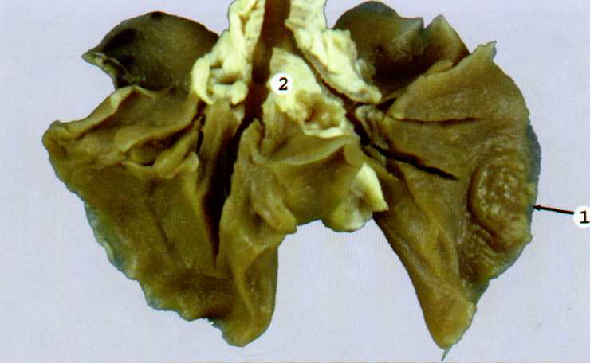
Primary tuberculosis complex

Slide 10
Variants of a current of primary tuberculosis
1. The progression of of primary tuberculosis:
growth of primary affect with the formation of of primary pulmonary cavity (galloping consumption)
hematogenous spread with the development of miliary tuberculosis and tuberculous meningitis,
mixed variants progression

Slide 11
2. The attenuation of primary tuberculosis
In the area of primary affect, the formation of hem or dehydration, and encapsulation of petrification. In general fibrous capsule can be hotbeds of ossification. This primary affect in the lung called Ghon's focus. This site rarely exceed 1 cm. It can serve as a repository of inactive carriers of the pathogen infection. The primary areas of the complex, which has evolved caseation, fibrosis occurs and petrification. So Ghon's complex is formed (calcification at the site of primary affect, in a lymph node calcification, fibrosis along the lymphangitis).

Slide 12
3. Chronically current primary tuberculosis these days is rare, mostly young social disorder persons (25-35 years).
The basis of this form is a slow progression of the specific inflammation in the lymph nodes, sometimes already healed primary affect. Typically involving all the new groups of lymph nodes, for a long period with periodic exacerbations.

Slide 13
Morphology.
Histologically, sites of active involvement are marked by a characteristic granulomatous inflammatory reaction that forms both caseating and noncaseating tubercles. Individual tubercles are microscopic; it is only when multiple granulomas coalesce that they become macroscopically visible. The granulomas are usually enclosed within a fibroblastic rim punctuated by lymphocytes. Multinucleate giant cells are present in the granulomas. Immunocompromised people do not form the characteristic granulomas.

Slide 14
The morphologic spectrum of tuberculosis. A characteristic tubercle at low magnification (A) and in detail (B) illustrates central caseation surrounded by epithelioid and multinucleated giant cells. This is the usual response seen in patients who have cell-mediated immunity to the organism.

Slide 15
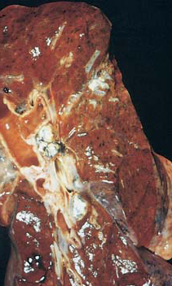
Primary tuberculosis complex

Slide 16
hematogenic tuberculosis
There after suffering a primary tuberculosis;
Mostly productive tissue reaction (granuloma);
Marked tendency to hematogenous generalization;
The defeat of various organs.

Slide 17
hematogenic tuberculosis
Classification.
1. Systemic hematogenic tuberculosis
2. hematogenic tuberculosis, mainly affecting the lungs
3. hematogenous tuberculosis predominantly extrapulmonary lesions

Slide 18
Systemic hematogenic tuberculosis
Systemic miliary tuberculosis occurs when bacteria disseminate through the systemic arterial system. Miliary tuberculosis is most prominent in the liver, bone marrow, spleen, adrenals, meninges, kidneys, fallopian tubes, and epididymis, but could involve any organ.
Miliary name comes from the Latin word "millia", which means millet. The size of the the tubercles 1-2 millimeters, they are gray-yellow, not prone to integration.

Slide 19
miliary tuberculosis of the liver

Slide 20
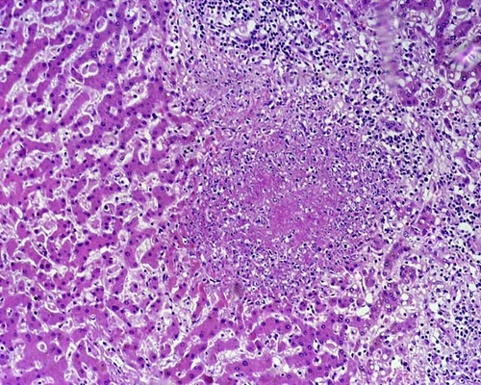
miliary tuberculosis of the liver

Slide 21
hematogenic tuberculosis, mainly affecting the lungs
Depending on the size of focus isolated miliary and macrofocal form hematogenic tuberculosis.
Miliary pulmonary tuberculosis (acute and chronic).
Characterized by the presence of numerous small the tubercles. Lung fluffy, swollen (due to perifocal emphysema), in all parts of both lungs are visible yellowish-white bumps the size of a grain of millet.
At a chronic scarring occurs within the tubercles, small focal and diffuse fibrosis, emphysema, pulmonary heart disease causes the formation of a right ventricular hypertrophy.

Slide 22
2. Macrofocal (hematogenic-disseminated) pulmonary tuberculosis in adults usually occurs chronically.
In both lung subpleural located symmetrical of large foci with formation in their decay "spectacle" caverns, the development of fibrosis, emphysema, pulmonary heart disease. Cause of death - chronic pulmonary heart disease.

Slide 23
hematogenous tuberculosis predominantly extrapulmonary lesions
The forms of extrapulmonary tuberculosis:
osteo-articular form,
tuberculosis of the urinary system,
tuberculosis of the reproductive system,
tuberculosis of the nervous system,
scrofuloderma

Slide 24
Osteo-articular form often presented tuberculous spondylitis, coxitis tuberculous gonitis.

Slide 25
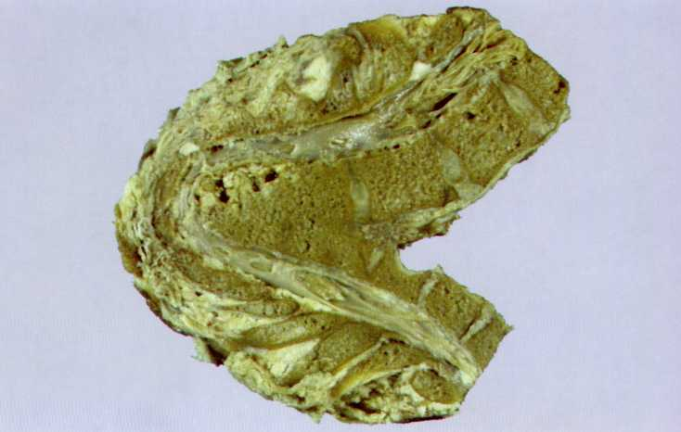
tuberculous spondylitis

Slide 26
Secondary tuberculosis
- Predominant lung damage without lymph node involvement;
- 1,2,6 increasingly affected segments of the right lung
- Change of clinical and morphological forms, which are the phases - TB in the lungs.

Slide 27
Forms secondary tuberculosis:
1) Acute focal tuberculosis;
2) Fibro - focal tuberculosis;
3) infiltrative tuberculosis;
4) tuberculoma;
5) caseous pneumonia;
6) Acute cavernous tuberculosis;
7) fibrous - cavernous tuberculosis;
8) cirrhotic tuberculosis.

Slide 28
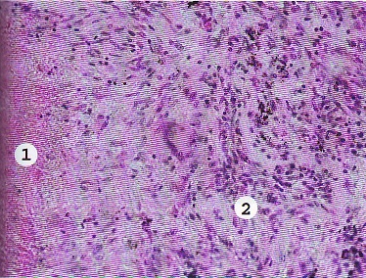
Fibro - focal tuberculosis

Slide 29
Caseous pneumonia - often, continued infiltrative form. The scale of destruction - from acinar to lobar. Characterized by massive caseosa necrosis followed by its disintegration and exclusion. Lung enlarged, dense, yellow color on the cut with fibrinous deposits on the pleura. Caseous pneumonia is possible in the terminal period of any form of tuberculosis in immunocompromised patients.

Slide 30
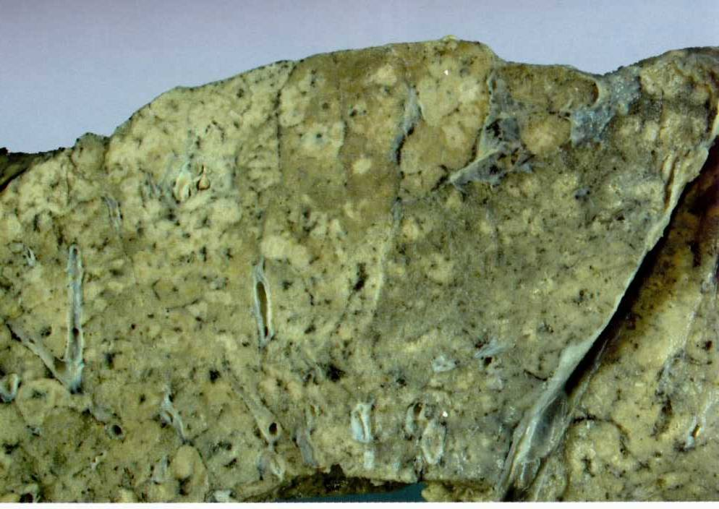
caseous pneumonia

Slide 31
Fibrous-cavernous TB (pulmonary consumption) has a chronic course.
At the top of the lung cavity with a thick wall of dense, rough inner surface of the cavity, the cavity cross sclerotic vessels and bronchi. The inner layer of the cavity presented caseous masses. The middle layer of many epithelioid cells, Langhans multinucleated giant cells and lymphocytes. The outer layer is formed by a fibrous capsule.

Slide 32
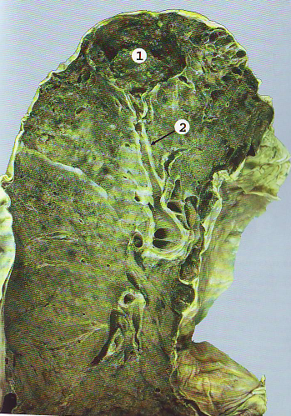
Fibrous-cavernous TB

Slide 33
Patients fibrocavernous pulmonary tuberculosis present the greatest threat to public health require the isolation and prolonged chemotherapy.

Slide 34
In secondary tuberculosis infection in the canalicular or contact occurs defeat the bronchi, trachea, larynx, mouth, intestines.
Hematogenous spread of infection in secondary tuberculosis is rare. This is possible in the terminal stage of the disease while reducing the body's defenses.

Slide 35
Complications secondary tuberculosis
Bleeding from damaged large vessels, especially repeatedly, can lead to death from the posthemorrhagic anemia.
Gap of the cavity into the pleural cavity causing pneumothorax, pleurisy, tuberculous empyema, bronchopleural fistulas.
Secondary amyloidosis is developed with prolonged duration of tuberculosis.

